Slide 1
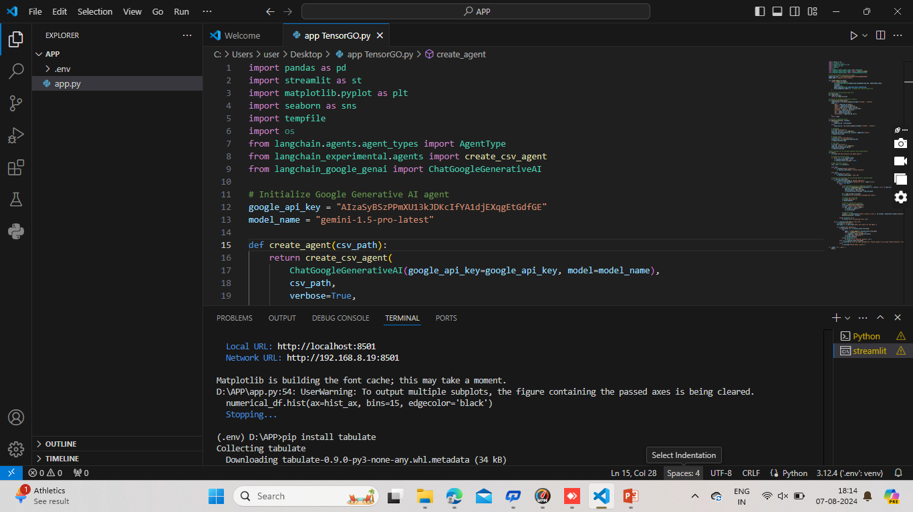
Code for creating CSV Data analysis
&
Agent Query app by using Visual Studio

Slide 2
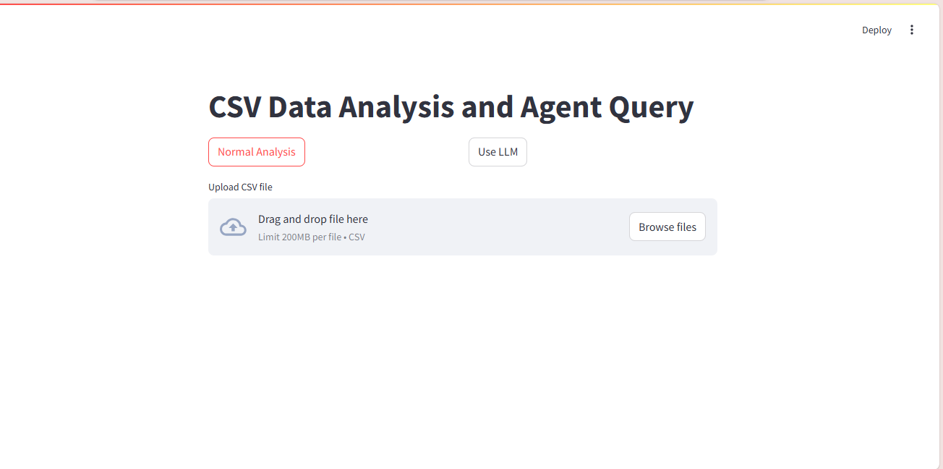
CSV DATA ANALYSIS REPORT AND AGENT QUERY

Slide 3
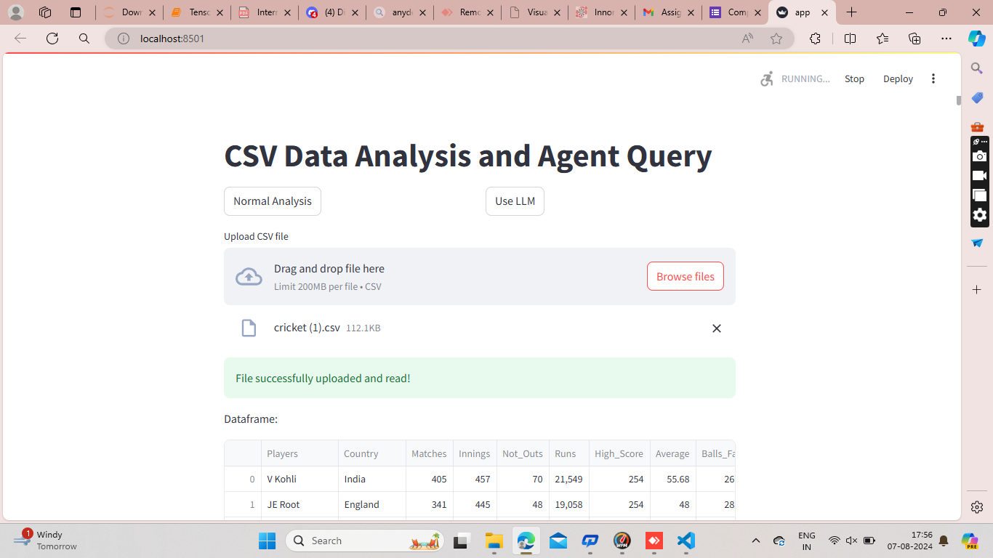
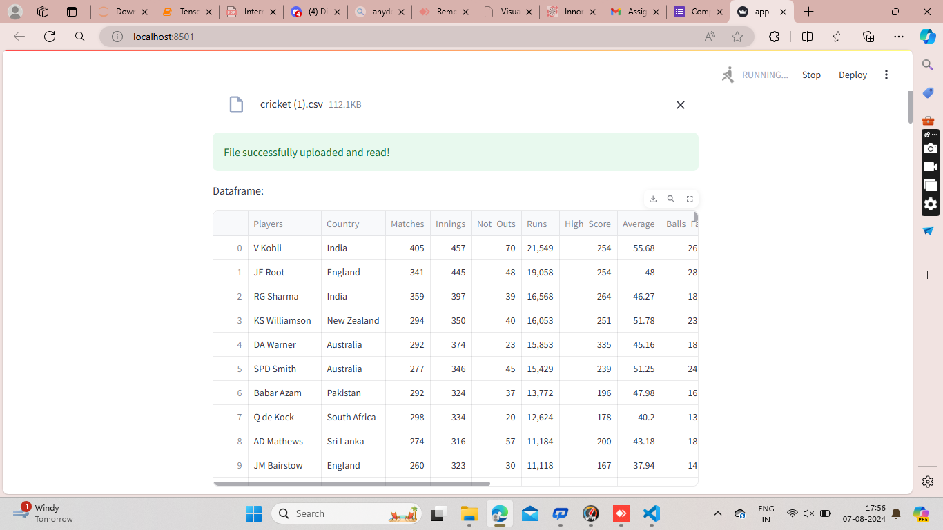
After uploading CSV file the output reports

Slide 4
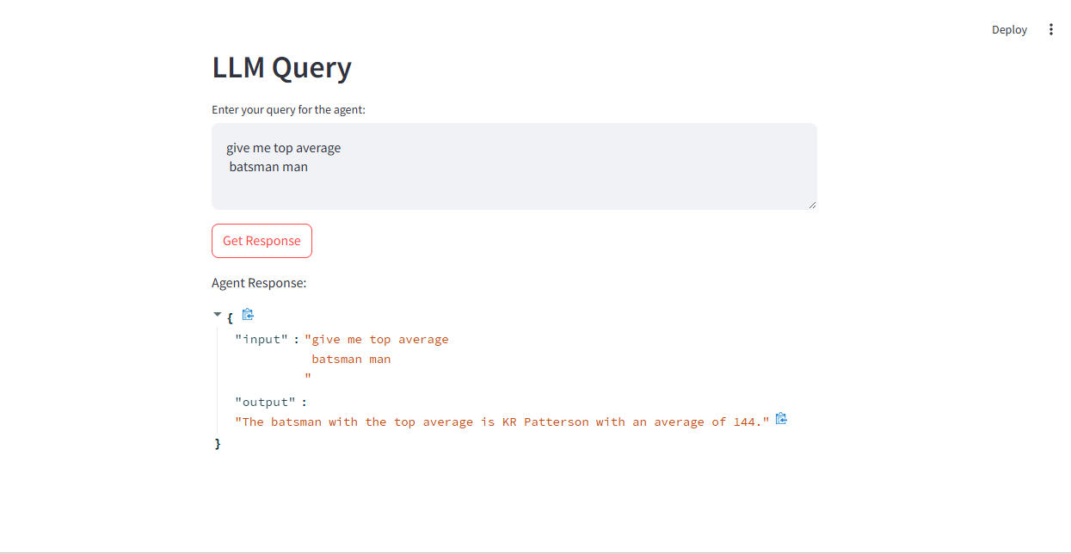
After uploading file use LLM as Query's/Questions

Slide 5
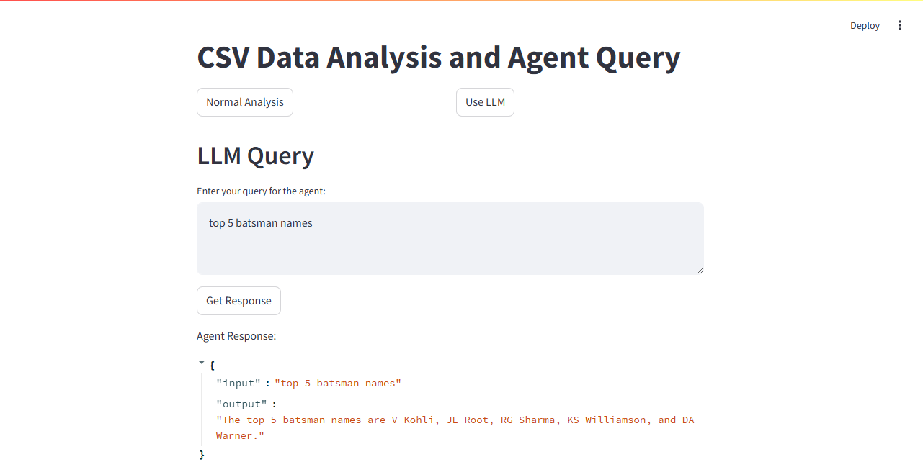
Another Query asking LLM by using Agent Query

